Slide 1
BPM Implementation
IS205
Jan-19
Dr. Ibrahim Abunadi

Slide 2
What are the critical implementation aspects?
Implementation is all about balance and cohesion between the organizational (business) and IT aspects. Getting this balance correct will allow the BPM project to be finished in the most effective and efficient way.
A useful metaphor is the Regatta®.
The slogan used is ‘Speed (efficiency) and effectiveness through balance and cohesion’. (p.38)

Slide 3
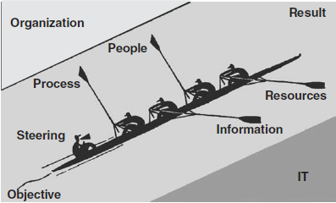
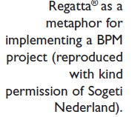
What are the critical implementation aspects? (p.39)

Slide 4
What are the critical implementation aspects?
The critical aspects in the Regatta model includes:
  Speed (Efficiency) is crucial – the overall aim is to win, and you win by being the first (fastest) across the finish line. Effectiveness relates to ensuring that all the available energy and enthusiasm is used optimally to realize the desired result – that is, to get the best out of the entire team. In a BPM project/organization, the aim is to ensure that everyone is contributing sufficiently to realize the desired results. In a BPM project/organization, the aim is to focus on realizing benefits from the business processes.
  Balance is required to ensure that the boat does not lean sideways or tip over, which would not be good for its speed and efficiency. Balance is achieved by carefully matching the strength, weight and experience of all the participants in the boat. In a BPM project/organization, the aim is to ensure that all implementation elements (management, process, people, project management, resources and information) are considered when implementing a solution. (p.38)

Slide 5
What are the critical implementation aspects? 2
The critical aspects in the Regatta model includes:
  Process is on the first oar, and this is the person who dictates the speed to other rowers. In a BPM project/organization, the business process should be leading and the technology and people should follow.
  Management (project manager, CPO, project sponsor) steers the boat in a straight line directly to the finish, ensuring that it does not go off course or get stuck on the shore. If a BPM project/organization places too much emphasis on resources and information (the IT aspects), then the project will be pushed onto, and could get stuck on, the organization bank (aspect) – for example, people who are not committed. Alternatively, if a BPM project/organization places too much emphasis on the people and process (=organization aspects), the project ‘boat’ could get stuck on the IT bank (aspects) of the project, for example, the resources (hardware and software) which are unable to meet the desired results. (p.39)

Slide 6
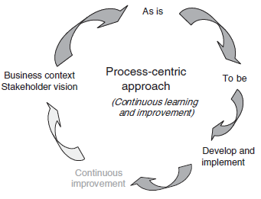
Why do you need a structured approach to implementing BPM? (p. 40 & 41)
The traditional way that most organizations have gone about process improvement projects can be shown with the Deming Cycle (Walton, 1986) of Plan, Do, Check and Act. This has evolved into the following:

Slide 7
Why do you need a structured approach to implementing BPM? 2
The traditional Plan, Do, Check and Act would become more complete by:
  Conduct a review of the areas to be improved, understand the business objectives, collect stakeholder requirements and select the initial processes to be improved
  Complete the ‘As is’ mapping in sufficient detail to understand the process and learn how to improve it
  Agree the timeframe for the delivery of the redesigned processes with the business and complete the ‘To be’ step to redesign the processes
  Implement the redesigned processes.
  Establish a continuous process improvement program within the organization to change the processes as the business changes. This completes the feedback loop. (p.40 & 41)

Slide 8
Why do you need a structured approach to implementing BPM? 3
One of the key questions in this approach is, ‘have you solved the correct problem?’ How can you be certain that the way you have redesigned your processes contributes to the organization’s strategic vision or intent?
Stace and Dunphy (1996) say that:
  “strategy is the search for directions which energize the life of an organization; structures provide the social organization needed to facilitate the strategy….Strategy and structure need to be constantly re-examined and realigned to be effective.” (p.41)

Slide 9
Prahalad’s Three Agendas
Three agendas must work simultaneously and continuously together:
The intellectual agenda. This is what some call strategy; while others have described it as an organization vision or strategic intent. This is referred to as ‘Organization goals and measures of organizational success’ in in the figure below.
The management agenda. This consists of the structures, technologies and systems of the organization. It includes how management chooses to utilize and move resources within the organization to meet the organization needs. We would explicitly include processes in this agenda, and this is shown as the ‘Organization management’ column in in the figure below.
The behavioural agenda. This covers the culture, values, ethics, leadership styles, personnel training, skills and key performance indicators of the people within the organization. It is important here to ensure that the reward systems respond appropriately to the behavior you wish to promote. This is shown as the last row ‘Performance and measurement’) in the figure below. (p.41)

Slide 10
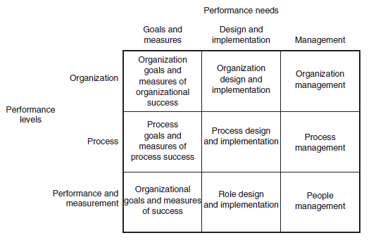
Performance Components (p.42)

Slide 11
Case study: Importance of understanding organization strategy
We were asked to review the current processes in the operations area of an organization and to recommend how they should go about an improvement program. There were two options put forward. The first was for incremental process improvement, with no additional automation, and the second was for an automated BPM solution. It was interesting that both options met the designated process goals, which the client had documented. So we asked them to describe their organization strategy for the next three years. The organization’s strategic intent was that it: will place us substantially ahead of our competition, such that it will be difficult for competitors to match the process and systems service levels able to be consistently achieved. This will form the foundation of our competitive advantage in the near and medium term. The incremental option would have provided incremental improvement. Only three out of the twenty five processes could be redesigned totally, whereas the remaining processes would have only been incrementally improved. The automated BPM option would have provided substantial innovation and integration with other critical systems, as well as the ability to provide the organization with continuing business agility. Message: It became obvious for our client to choose the automated BPM option. Unless the project manager clearly understands the organization’s strategy, and ensures that the project satisfies and adds value to this strategy, then the project runs the risk of ‘solving the wrong problem’. (p.43)

Slide 12
How to implement?
Having linked the organization strategy with the supporting process goals and created the redesigned processes, you must ask, ‘who will implement these new processes?’ The answer is, the people within the organization.
Unless the organization structure, role descriptions, skill sets and reward systems support and are in alignment with the organization direction, you will only be covering the first two of Prahalad’s agendas.
Once all these areas have been addressed, the organization must ensure that there is an ongoing process to ‘manage’ and continuously to improve the business processes.
Implementing a BPM project is a multi-faceted and complex process that, if tackled without a structured approach, either will not work or will not meet the expectations of the stakeholders. However, over-applying a methodology or framework will not provide the flexibility required to meet the varying challenges. (p. 43)

Slide 13
BPM Improvement framework
Literature has suggested that there are three critical aspects to a process improvement project: people, process and technology. Adding to at a forth component called project management:
  1 Process. There must be an appropriate level of business process innovation or redesign linked to the organization strategy and process goals, and an acceptance of the importance of processes within the organization.
  2 People. As an organization grows in its maturity of process management, it will understand that people are the key to implementing the proposed new processes. The organization must have the appropriate performance measurement and management structures across key processes. Process management should be proactive and then move towards being predictive, rather than reactive. Amongst other things, this all revolves around the people aspects of a BPM project.
  3 Technology. This refers to the supporting tools for the processes and people and does not necessarily mean BPM software components or applications (although it could).
  4 Project management, for without a well-run project an implementation is destined to failure (p.47)

Slide 14
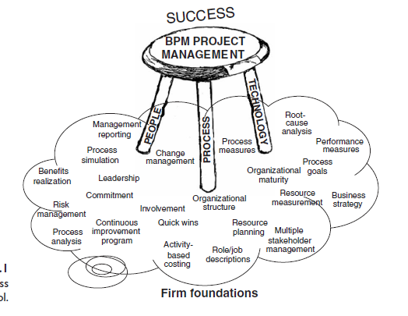
BPM Improvement framework 2 (p.49)

Slide 15
Foundation of BPM Improvement Success
BPM projects are complex, and success depends upon all aspects of the project being executed well. These aspects are represented by the ‘foundations’ upon which the stool rests. If these foundations are soft (or not executed successfully), then the stool will sink and eventually collapse. If the foundations are firm, however, because they are executed well, the stool will be resting upon a solid foundation and the project will be successful.
Symptoms which indicate that an organization is struggling with executing these components are that:
  it doesn’t know where to start
  it is not making the headway that was anticipated or planned
  it has purchased a technology tool and thinks this is the answer
  redesigned processes are not implemented
  insufficient benefits are being realized
  it is doing process improvement for the wrong reason (‘everyone else is doing it, so should we!’)
  BPM is making little impact on the organization, perhaps because the scope is too small or too large, or because the organization is endeavoring to be too ambitious. (p.49)

Slide 16
Foundation of BPM Improvement Success 2
Before an organization can improve business processes, there must be an understanding of factors that influence it. Unless there is full appreciation of the culture and behavior of the people using the processes, you cannot know that the changes will be effective.
This is not just about aligning strategy and processes, but also people and behaviors. Performance management and measures, change management and communication will also impact a BPM project. Effective communication across all organizational levels is critical to BPM project success.
Organization results are a function of how the critical components are synchronized, and the critical components include:
  strategic intent
  strategic vision
  execution
  values/culture/behaviors
  people. (P.48)

Slide 17
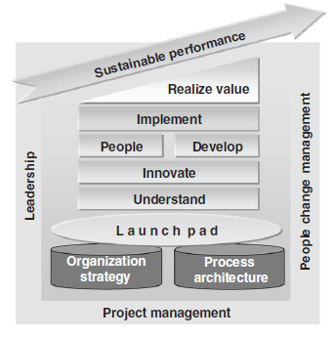
BPM Implementation Framework (P.49)

Slide 18
BPM Implementation Framework
There are ten phases in this framework. The phases are:
    1 Organization strategy
    2 Process architecture
    3 Launch pad
    4 Understand
    5 Innovate
    6 Develop
    7 People
    8 Implement
    9 Realize value
    10 Sustainable performance. (P.50 & 51)

Slide 19


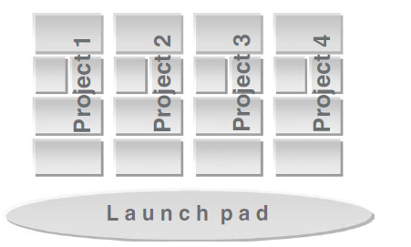

Organizational approach to BPM implementations (P.51)

Slide 20


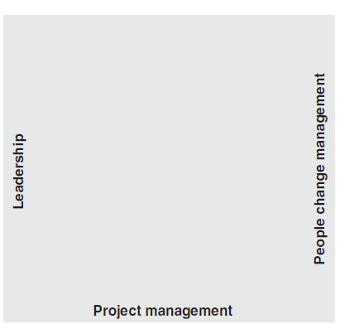
Organizational approach to BPM implementations 2 (P.52)

Slide 21
Framework Phases 1
Each of the phases will be outlined :
Organization strategy. This phase includes ensuring that the organization strategy, vision, strategic goals, business and executive drivers are clearly understood by the project team members. Do stakeholders expect short- or long-term gains from this project? Is the value proposition of the organization clear and understood by everyone? It is important to understand that strategy is not a ‘plan’; strategy ‘is a purposeful process of engaging people inside and outside the organization in scoping out new paths ahead’ (Stace and Dunphy, 1996: 63). The strategy must be communicated and sold to all relevant stakeholders (especially the management and staff) until it becomes entrenched in the culture of the organization. Personnel need to take it up with urgency and, ideally, a sense of passion. The strategy needs to be known and understood by the project team, which ensures that the project scope and direction add value to it. (p.53)

Slide 22
Framework Phases 2
Process architecture. This phase is where the process architecture is designed. Process architecture is the means by which the organization establishes a set of rules, principles, guidelines and models for the implementation of BPM across the organization. The process architecture provides the basis for the design and realization of BPM process initiatives. It is where the process, IT and business architectures are brought into alignment with the organization strategy. (p.53)

Slide 23
Framework Phases 3
Launch pad. This phase has three major outcomes:
the selection of where to start the initial (or next) BPM project within the organization
agreement of the process goals and/or vision, once the processes have been selected
the establishment of the selected project.
Determining where to start is a difficult exercise in its own right, and the framework will provide you with several ways of determining where and how to start. Process goals and vision need to be aligned with the organization strategy and the process architecture to ensure that they are enhancing or adding value to the strategy. Once a business unit and processes have been selected and the process goals agreed, the project must be established to maximize the likelihood of success. Establishing the project includes deciding the project team structure, the scope, the stakeholder management, creation of the initial business case, and expected business benefits. (p.54)

Slide 24
Framework Phases 4
Understand. This phase is about understanding enough of the current business process environment to enable the Innovate phase to take place. It is essential that at least basic process metrics are gathered to allow for the establishment of process baseline costs for future comparative purposes. Other essential steps are root-cause analysis and the identification of possible quick wins. There will be a need to identify, and ideally implement, quick wins along the way, as the business will not (and should not) provide unlimited funding for process improvement projects. The ideal situation is for the project(s) to become self-funding because of the gains made by the implementation of these quick wins. (p.54)

Slide 25
Framework Phases 5
Innovate. This is the creative phase of the project, and often the most interesting. It should not only involve the project team and the business, but also relevant stakeholders – both internal and external. Once the various new process options have been identified, there may be a need to run simulations, complete activity-based costing, conduct capacity planning and determine implementation feasibility, to enable the finalization of which options are the best. Additional metrics should be completed to allow a comparison with the baseline metrics established during the Understand phase. Additional possible quick wins are identified and prioritized within the business. (p.54)

Slide 26
Framework Phases 6
Develop. This phase consists of building all the components for the implementation of the new processes. It is important to understand that ‘build’, in this context, does not necessarily mean an IT build. It could involve the building of all infrastructure (desks, PC movements, buildings, etc.) to support the people change management program and changes in the support of the people who execute the processes. It also involves the testing of software and hardware. (p.54)

Slide 27
Framework Phases 7
People. This is a critical phase of the framework and it could put the rest of the project at risk if not handled thoroughly and to a high standard. The purpose of this phase is to ensure that the activities, roles and performance measurement match the organization strategy and process goals. At the end of the day, it is people that will make processes function effectively and efficiently, no matter how much automation is involved. This phase should not be confused with people change management, as this needs attention throughout the project in all the phases. (p.54 & 55)

Slide 28
Framework Phases 8
Implement. This phase is where the ‘rubber hits the road’. It is where all aspects of the project (roll-out of the new processes, roll-out of the new role descriptions, performance management and measures, and training) take place. The implementation plans are crucial, as are roll-back and contingency plans. Many organizations believe that the project has been completed after implementation has been successful. However, in our opinion the next two phases are the most important in a BPM project. (p.55)

Slide 29
Framework Phases 9
Realize value. The purpose of this phase is to ensure that the benefit outcomes outlined in the project business case are realized. This phase basically comprises the delivery of the benefits realization management process, and benefits realization reporting. Unless the benefits are realized, the organization should not provide additional funding to continue further process projects. It is the role of the project team, project owner, project sponsor and business to ensure that these benefits are realized. Although this is described as the ninth phase of the framework, it is in fact not a discrete phase in its own right because some of the steps are executed in previous phases. Therefore, we advise the reader to study the appropriate part of this chapter in conjunction with every other phase. The steps have been grouped together in this chapter to provide an end-to-end insight into the role of realizing value in a BPM project and to ensure that the BPM project team takes time after the Implement phase actually to realize the benefits specified in the business case. (p.55)

Slide 30
Framework Phases 10
Sustainable performance. It is absolutely essential that the project team works with the business to establish a process structure to ensure that continued process agility and improvements are sustainable. The considerable investment made in process projects must be maintained and enhanced over time. The organization must understand that processes have a lifecycle, and will need continuous improvement after the project’s targeted improvements have been realized. If they don’t, over time and as the business changes the organization will simply be running its processes in a sub-optimal fashion. This phase is about the conversion from a ‘project’ to a ‘business operational’ activity. (p.55)

Slide 31
Projects Essentials
There are three BPM project essentials. These are the essential components upon which any successful BPM project rests, and they permeate[penetrate] all phases of the project framework:
Project management. Clients often ask, ‘can a normal application or business project manager implement a BPM project?’ The answer is a qualified ‘Yes, but nowhere nearly as well as an experienced BPM project manager’. The project risks will be significantly higher, and the organization risks missing out on many of the potential benefits that can be achieved from BPM. Can a person without significant project management experience implement a BPM project? This answer is easy – ‘no’. Project management is a fundamental skill or requirement for any project, and a BPM project is no different. In fact, the requirement is even higher because of the increased complexity of BPM projects. (p.55 & 56)

Slide 32
Projects Essentials 2
People change management. We will look at the importance of the change process as it specifically relates to the implementation of the personnel aspects of a BPM project. There have been many articles written on why process improvement and BPM project failures occur, and we do not propose to mention all the reasons here. However, there is a growing belief that the personnel aspects of an improvement project have not always been addressed in sufficient detail. As Michael Hammer stated in 1993, ‘coming up with the ideas is the easy part, but getting things done is the tough part. The place where these reforms die is … down in the trenches’ – and who ‘owns’ the trenches? The people in the organization. (p.56)

Slide 33
Project Essentials 3
Leadership. A point acknowledged by all business process change experts is that any change program must have the support of senior leadership/management to be successful. According to Keen (1997: 119), ‘These people’s commitment to change matters more than the details of the plan for change’. The extent to which executive leaders ‘delegate’ responsibility is crucial to the effectiveness of the outcomes of BPM projects. We have witnessed extremely successful BPM implementations and some poor ones, and the common thread in both types has always been the commitment, attention and process maturity of the executive leaders. The successful projects had excellent executive commitment, attention and understanding, while the poor ones did not. (p.56)

Slide 34
Case study: Leadership is about drive not about position
A senior executive leader within an organization had a strong process-centric view and commitment, and was extremely successful in realizing benefits from processes in one of the major business units of the organization. The CEO of the same organization did not have such a strong process view, and tried to drive process improvement throughout the organization. He could not gain the attention and passion of the other executive leadership. As a consequence, he did not obtain the business benefits he sought within the rest of the organization.
Message: The executive responsible for the implementation of BPM must be passionate and committed to its success, and able to ‘sell’ this passion and commitment to all others involved. (p.56)

Slide 35
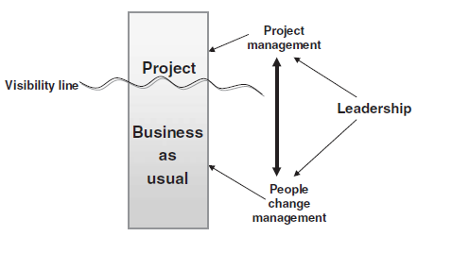

BPM project essentials dynamics (p.56)
If we bring these three BPM project essentials together and show their relationship diagrammatically, it gives us this Figure:

Slide 36
BPM project essentials dynamics 2
The figure shows that the perception is often that a BPM project is seen as being above the visibility line (that is, having a high visibility within the organization) whilst the business operational activities are seen as not having as high a visibility and hence as being below the visibility line.
Project management relates to projects and people change management primarily relates to the business-as-usual activities, because that is where the business people are. Leadership’s role is to ensure these two essentials are brought together in a harmonious and seamless manner. It is important to stress that the framework does not need to be followed meticulously; it should be adapted for a specific organization or situation. (p.56 & 57)

Slide 37
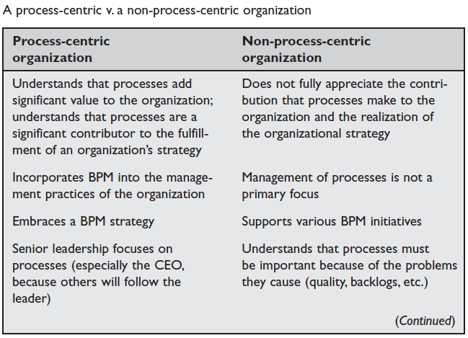
A process-centric organization
The easiest way to describe a process-centric organization is to compare it with an organization that is not process-centric:
P.84

Slide 38
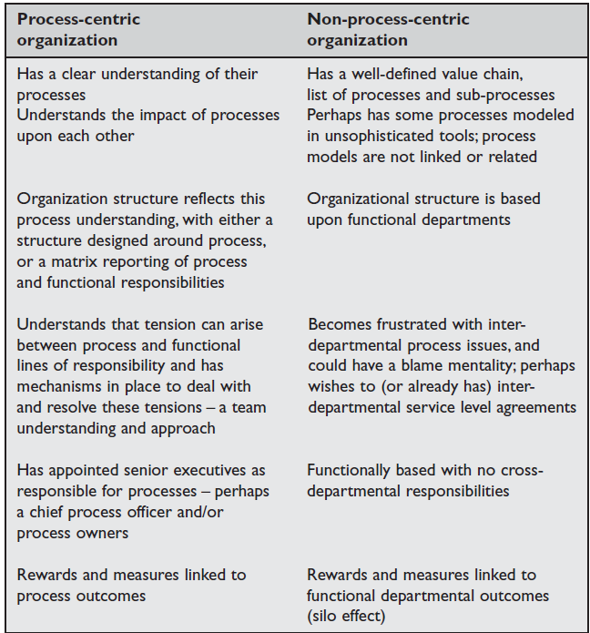
P.85

Slide 39
Guidelines on how to use the framework
Why a ‘one approach fits all’ philosophy does not work:
The difficulty with any structured approach to business projects, whether a BPM project or not, is that organizations often adopt a ‘one approach fits all’ philosophy.
Many people suggest that a BPM project should start by first obtaining the full and complete support of the CEO, and unquestionably this is the ideal method. In reality, though, most CEOs either do not know about the BPM project or will not be interested because it is considered to be ‘just another project’. If they are aware of the project and it is one of the first BPM projects within the organization, they might want proof of the benefits that BPM can bring.
Even if the CEO is interested, it is often the case that the BPM initiative does not get sufficient attention, time and resources from the CEO. Business processes are at the heart of an organization and require more than just lip service to monitor, manage and improve them. This lack of attention, time and resources can have a significant negative impact on the execution of the BPM initiative.
In addition, most approaches do not cater for the various stages of experience and embedding of BPM within an organization – from the initial orientation of BPM as an important part of management, through to a business-as-usual activity. Obviously, there will be a fundamentally different approach depending upon the level of organizational experience with BPM. (p.59)

Slide 40
Guidelines on how to use the framework 2
Why a ‘one approach fits all’ philosophy does not work:
In the ideal situation, the organization will have established and published its strategic vision, objectives and goals. It will have embraced BPM, aligned the organization strategy with BPM and set about establishing the process architecture – these being the pillars upon which individual BPM projects can be launched.
The process architecture will also have been aligned with the organization’s strategy and the IT and business architectures. However, most situations are not ideal. (p.60)

Slide 41
How are BPM projects selected?
How an organization determines that a BPM project is required is fundamental to how the project will be conducted and how the framework will be used by the organization and the project team. There are two primary methods used by organizations to commence a BPM project.
The method chosen will significantly influence why, where and how a project is selected. Which method is selected will be determined by the particular needs of the organization, the BPM maturity of the leadership team, and the leadership style of the CEO and senior executive management. The two methods of BPM project initiation we refer to as strategy- driven and operational initiative approaches. (p.60)

Slide 42
The strategy-driven approach
The strategy-driven approach is where the organization’s strategy is being executed by the leadership team, and the transition from strategy to implementation will mean that the organization’s leadership has determined that certain implementation projects will have an impact upon some of the organization’s business processes.
To address this impact there will be a need to change or redesign a number of business processes, which will mean commencing BPM projects.
This is ‘top-down’ management of an organization’s processes. The BPM project portfolio will, therefore, be determined, planned and reviewed as a result of the strategy process, which comes either from a strategic change or a periodic strategic review.(p.60)

Slide 43
The strategy-driven approach 2
The sequence is that the organization strategy will have determined that a BPM project is necessary and will know which processes will be impacted, and therefore which processes will be part of the BPM project. As this is likely to be a BPM-mature organization, it will in all probability have a process architecture, which will need to be referenced throughout the project.
The Launch pad phase may complete a few of the steps in less detail than normal, but will still need to establish the project structure and team. The remaining framework phases will still need to be completed. (p.60)

Slide 44
The operational-initiative approach
An operational-initiative approach will, as the name suggests, be an initiative driven by the operational needs of an organization, business unit or department.
The triggers for this type of BPM project are likely to originate from a business problem. Operational initiatives will mean that the determination that a BPM project is required occurs at a lower level within an organization than at the strategy level. The likely starting point will therefore be at the Launch pad phase.
A small project team will commence several of the Launch pad phase steps to assess and gather sufficient information to know exactly where to start, and to determine the depth of the project.
This will mean that the Organization strategy and Process architecture phases of the framework will not be completed in their entirety, but rather only referenced for relevant information. It remains crucial to ensure alignment with the organizational strategy. (p.60 & 61)

Slide 45
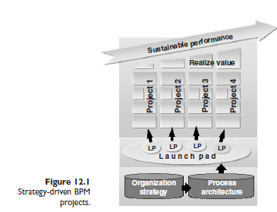
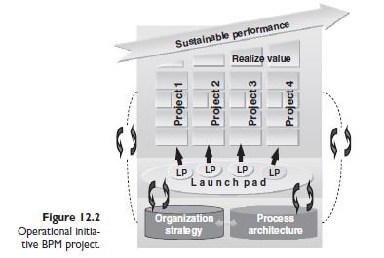
Comparison
Strategy-driven BPM
projects
Operational initiative
BPM project

Slide 46
Comparison 2
If compliance is the reason for commencing a BPM project, it should be considered from a strategic perspective. If it has the backing of executive management, then it is a strategic-driven approach; if it does not have the backing of executive management, then it should be considered to be an operational initiative approach.
The organization strategy and process architecture are the foundations of any BPM project. The more extensive and bigger the project, the stronger the foundations must be. This is why, in a strategy-driven approach project, there must be more effort in the Organization strategy and Process architecture phases than is the case in an operational initiative approach project.
No matter how the need for a BPM project is determined, the next decision the organization will need to make is what type of BPM project it will be.

Slide 47
Four scenarios in implementing BPM
There is distinction between the following four BPM project scenarios; which one is selected will be determined by many factors, and these are discussed here:
  1 ‘Business as usual’. This will be selected by the most BPM-mature organizations. The organization and business managers will be totally committed to a process-centric organization, and BPM projects are simply business-as-usual activities or projects.
  2 ‘In the drivers seat’. This is the next level of organization BPM maturity, and is where there is a fully informed business manager who is totally committed to the implementation of BPM within the organization or business unit he or she is responsible for.
  3 ‘Pilot project’. This is where there is a fully informed business manager who has yet to be totally convinced of the benefits of BPM and is willing to try it out on a small scale to start with before making a full commitment.
  4 ‘Under the radar’. This occurs in the least BPM-mature organization, and is where there is a partially informed business manager who is not yet committed and is not paying much (or any) attention to BPM within the organization. This scenario could be a project under the guise of process improvement, and BPM may not be mentioned at all. An interesting observation regarding this type of project scenario is that some organizations may complete many ‘under the radar’ BPM projects and still not obtain the attention of the appropriate business management in order to undertake BPM on a wider scale within the organization. (p.62)

Slide 48
How to determine which scenario is applicable
The scenario depends upon the involvement and commitment of the business manager. In this context, the business manager is the person who determines If compliance is the reason for commencing a BPM project, it should be considered from a strategic perspective.
If it has the backing of executive management, then it is a strategic-driven approach; if it does not have the backing of executive management, then it should be considered to be an operational initiative approach.
The organization strategy and process architecture are the foundations of any BPM project. The more extensive and bigger the project, the stronger the foundations must be. This is why, in a strategy-driven approach project, there must be more effort in the Organization strategy and Process architecture phases than is the case in an operational initiative approach project. No matter how the need for a BPM project is determined, the next decision the organization will need to make is what type of BPM project it will be. (p. 62)

Slide 49
Four scenarios in implementing BPM
We distinguish between the following four BPM project scenarios; which one is selected will be determined by many factors, and these are discussed here.
1 ‘Business as usual’. This will be selected by the most BPM-mature organizations. The organization and business managers will be totally committed to a process-centric organization, and BPM projects are simply business-as-usual activities or projects.
2 ‘In the drivers seat’. This is the next level of organization BPM maturity, and is where there is a fully informed business manager who is totally committed to the implementation of BPM within the organization or business unit he or she is responsible for.
3 ‘Pilot project’. This is where there is a fully informed business manager who has yet to be totally convinced of the benefits of BPM and is willing to try it out on a small scale to start with before making a full commitment.
4 ‘Under the radar’. This occurs in the least BPM-mature organization, and is where there is a partially informed business manager who is not yet committed and is not paying much (or any) attention to BPM within the organization. This scenario could be a project under the guise of process improvement, and BPM may not be mentioned at all. An interesting observation regarding this type of project scenario is that some organizations may complete many ‘under the radar’ BPM projects and still not obtain the attention of the appropriate business management in order to undertake BPM on a wider scale within the organization. (p.62)

Slide 50
How to determine which scenario is applicable
The scenario depends upon the involvement and commitment of the business
manager. In this context, the business manager is the person who determines the business strategy – for example, the executive general manager or CEO.
The more involved and committed this person is, the more impact the project can (and should) have on the organization.
Once an organization has fully implemented BPM (is process-centric and BPM mature), all BPM initiatives, whether small or large, will be ‘business-as-usual’ projects.
Once the organization has selected the implementation scenario for the BPM project and the project team has a clear understanding of how the BPM project was initiated, it will be able to commence using the framework.
Where appropriate, we have mentioned at each phase in the framework the impact of the scenarios on the steps to be used, and the depth of use that is needed. (p.63)

Slide 51
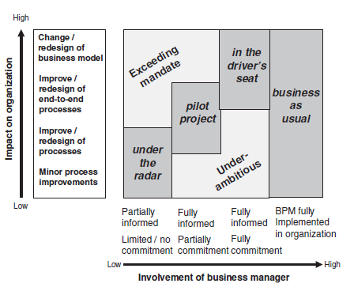
How to determine which scenario is applicable 2
The figure shows that it is important first to determine the business manager’s involvement; only then is it appropriate to review the impact on the organization (p.63)

Slide 52
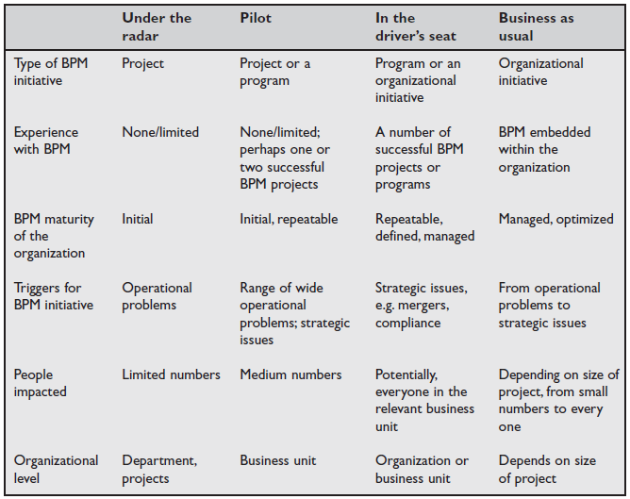
Characteristics of different BPM project scenarios (p.64)

Slide 53
Skipping of a phase
It is highly recommended that all phases of the framework be considered when executing a BPM project; however, there are situations in which not all the steps must be performed for a particular phase.
In a green-field situation, organizations may skip the Understand phase. However, it is quite rare that an organization or new business line will start from scratch, from a processes perspective.
In many cases, the organization will have already performed the proposed processes on a small scale and simply want to expand the activities on a larger scale.
In this situation, it is important to understand the process experience so far (on the smaller scale) in order to be in a better position to formulate appropriate processes for the future (Innovate phase).
If the organization wishes to skip a phase, or one or more steps within a phase, it is crucial that this is thoroughly reviewed and the impact of this action is determined and understood prior to skipping the phase or step(s). (p.63)

Slide 54
Iterative approach
At first inspection, it appears that our phased approach looks forward with the completion of one phase before the next phase. However, a closer examination of each phase will reveal that there are links to the phases before and after. There are two different levels of interfaces:
1 Project level. These are the interfaces between the various phases of a project. Some phases can be iterative – for example, between the Innovate and Develop phases there could be feedback and feed forward. A BPM solution could be chosen (in the Innovate phase) that, in the Develop phase, either provides additional features or not all the required features, which necessitates going back to the Innovate phase to review the situation and determine how to proceed. At the beginning of each phase, we show the main inputs from other phases. At the end of the chapter, we describe the main outputs from the current phase. These provide the main feed forward and feedback interfaces between phases. (p.64 & 65)

Slide 55
Iterative approach 3
Organization level. BPM itself is also a process and, as we will describe in later chapters, no process is complete without sufficient feedback loops to ensure that the organization learns from their experiences.
For example, as a result of executing a BPM project, there will be information obtained that may necessitate review of the organization’s strategy and process architecture.
At a more detailed level, a project post-implementation review will provide lessons learned that can be incorporated into future BPM projects (for example, the business case formulation in the Launch pad phase). (p.65)

Slide 56
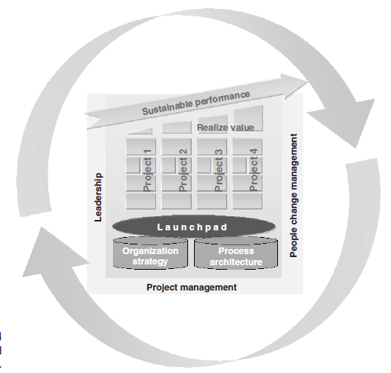
Iterative approach 3 (p.65)

Slide 57
References
Most slides are directly quoted or paraphrased from the following book(s):
Jeston and Neils, (2006) Business Process Management: Practical Guidelines to Successful Implementations.
Slides are prepared by Dr. Ibrahim Abu Nadi
All page numbers are from Jeston and Neils (2008), unless explicitly mentioned which reference it comes from.

